Slide 1
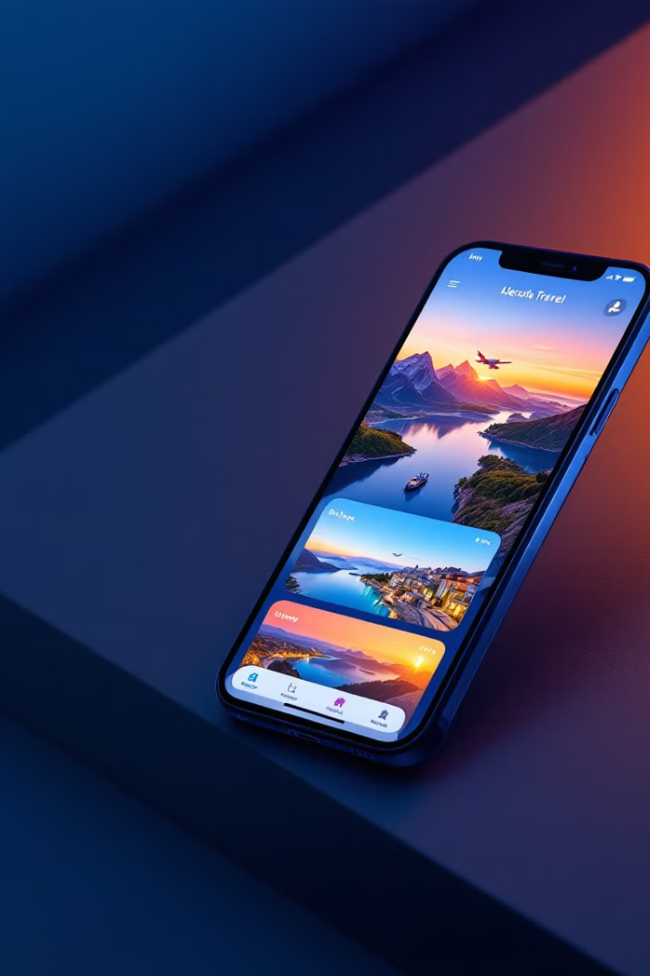
Travel Planning and Tracking App
TEAM NUMBERS
K.KAVINILA - E80BFD7A907237599F340DC44976C6A5
S.SHALINI- DAF14EBAD4D40959630468B3CD0E5E4A
K.RAJAKUMARI-D62E4CB839869459B1F455CCDE94BAEE
S.TAMILMANI-F3344B52DD04E2191F34D160E7705B95
S.DHARANISRI-DD8E83A8B10BC229BFE45DA0E9CD18A5
.

Slide 2
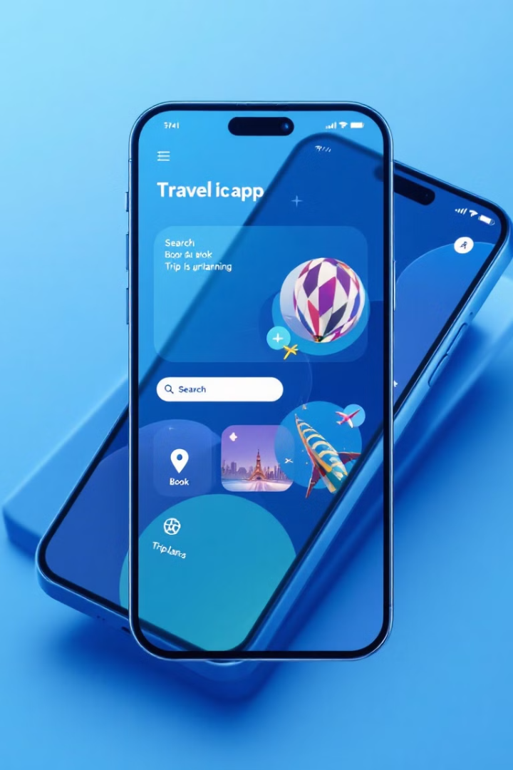
Introducing our app: Effortless travel made simple
Effortless Planning
Seamless Tracking
Discover destinations, research hotels, and book flights without hassle.
Monitor your expenses, stay within your budget, and optimize your itinerary.
Memorable Documentation
Capture your journey with photos and videos. Share your experiences with loved ones.

Slide 3



Plan your dream vacation: Discover destinations, hotels, flights
Explore Stunning Destinations
Discover Exquisite Hotels
Book Affordable Flights
Browse a wide selection of hotels, from cozy boutique hotels to grand resorts.
Find the best deals on flights with our intuitive flight search engine.
Search for places based on your interests, budget, and travel style.

Slide 4
Track your expenses and budget: Never overspend on your trip
Expense Tracking
Budget Management
Personalized Insights
Categorize and record all your expenses, from meals to souvenirs, in real time.
Set a budget for your trip and track your spending to stay within your limits.
Receive insights into your spending habits to make informed decisions.

Slide 5
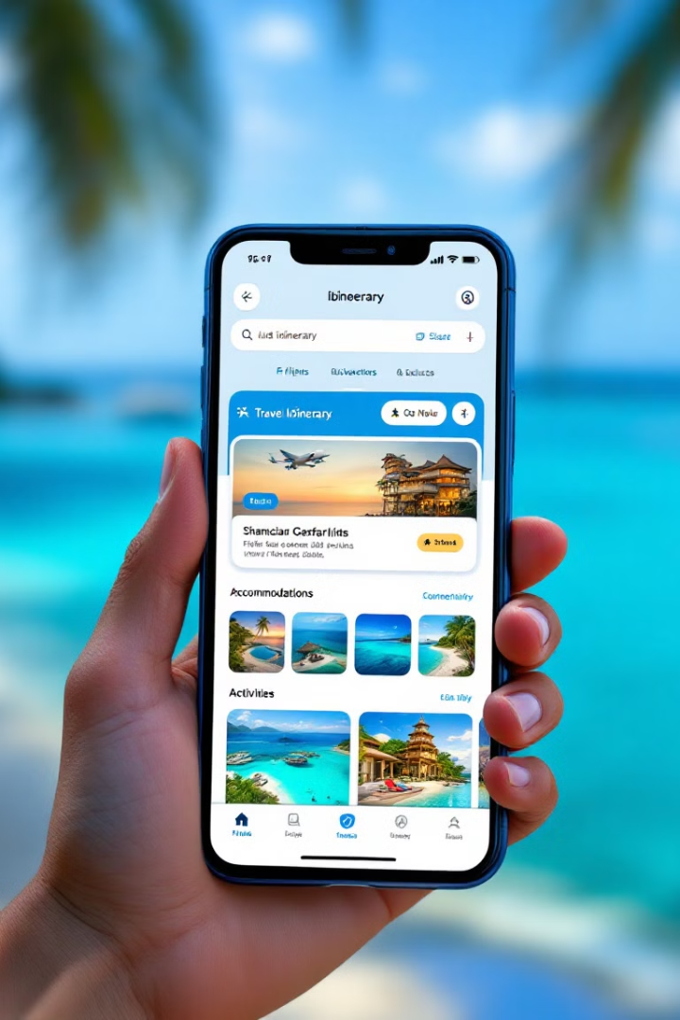
Plan Your Dream Vacation
Destination Search
Trip Builder
Explore destinations worldwide with detailed information on points of interest.
Create personalized itineraries based on your interests and budget.
Booking & Management
Book flights, accommodations, activities, and transport directly within the app.

Slide 6
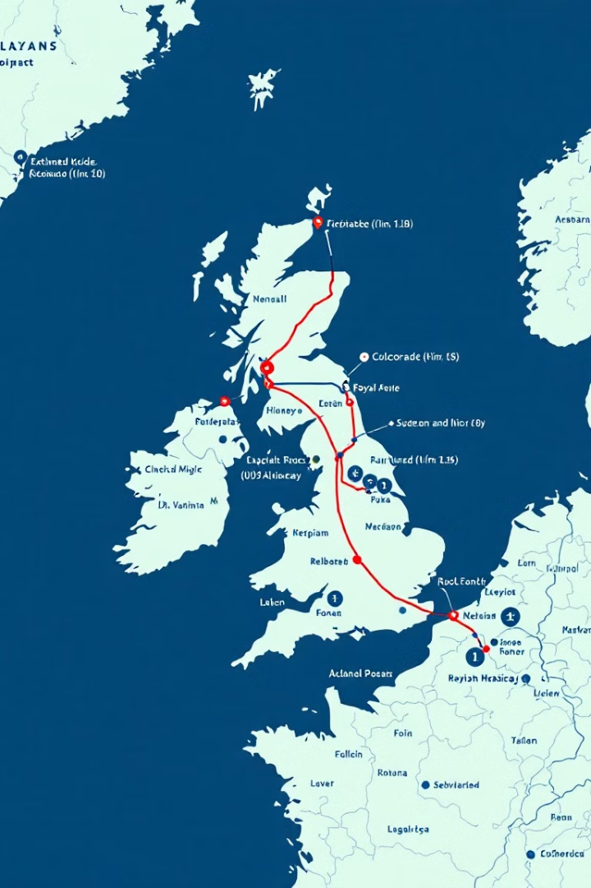
Optimize your itinerary: Seamless scheduling and transportation
1
Itinerary Builder
Plan your daily activities, schedule attractions, and create a personalized itinerary.
2
Transportation Integration
Book transportation, including flights, trains, taxis, and rental cars, directly through the app.
3
Real-Time Updates
Receive real-time updates on traffic and flight delays, keeping you informed and on schedule.

Slide 7

Track Your Travel Expenses
Category
Spending
Budget
Accommodation
$500
$600
Food & Drink
$200
$250
Transportation
$100
$150

Slide 8
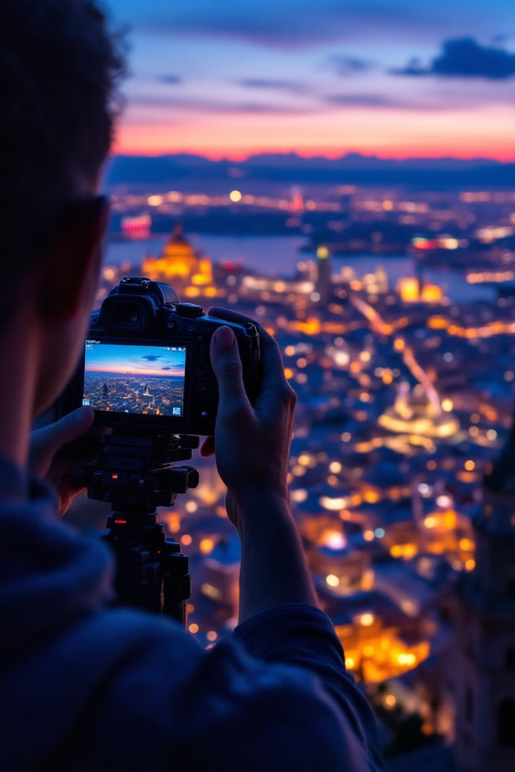



Document your journey: Capture memories with photo and video
Capture Your Memories
Take stunning photos and videos of your adventures using the app's built-in camera.
Create a Travel Journal
Document your thoughts, feelings, and experiences in a digital journal.
Share with Loved Ones
Share your memories with friends and family through social media or directly through the app.

Slide 9

Share your experiences: Connect with friends and family
1
Social Sharing
2
Connect with Travelers
Share your photos, videos, and stories with friends and family on social media.
Join a community of fellow travelers and share tips, advice, and recommendations.
3
Stay Connected
Keep in touch with loved ones while you're on the go, even if you're in a remote location.

Slide 10
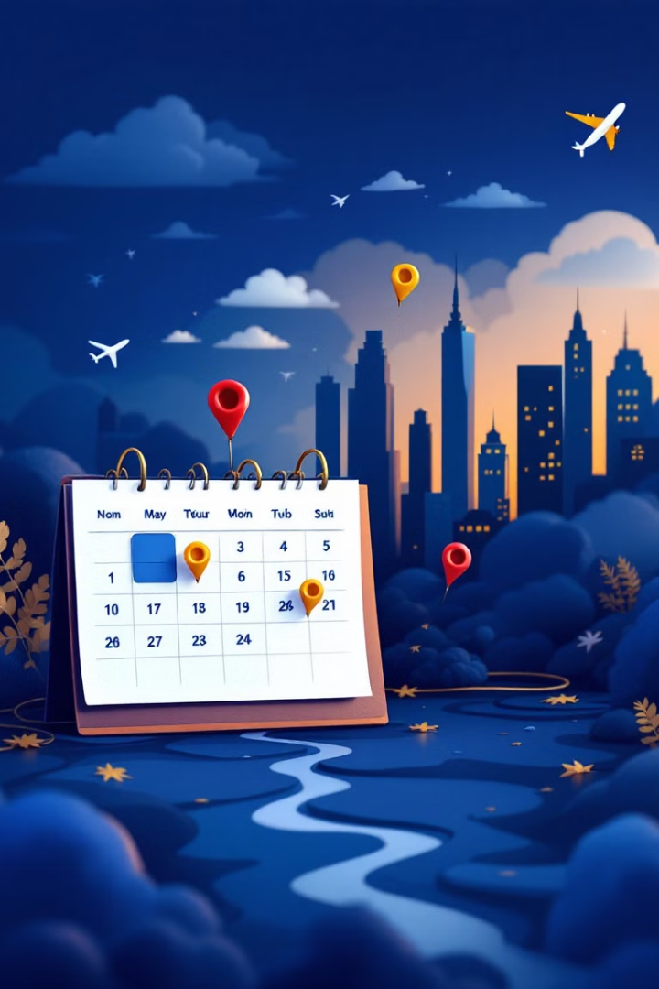
Organize Your Itinerary
1
Day-by-Day Planning
Create detailed itineraries for each day of your trip, including activities, timings, and locations.
2
Real-Time Updates
Keep track of your itinerary and receive notifications for flight changes, weather updates, and important reminders.
3
Offline Access
Access your itinerary and essential travel information even without an internet connection.

Slide 11
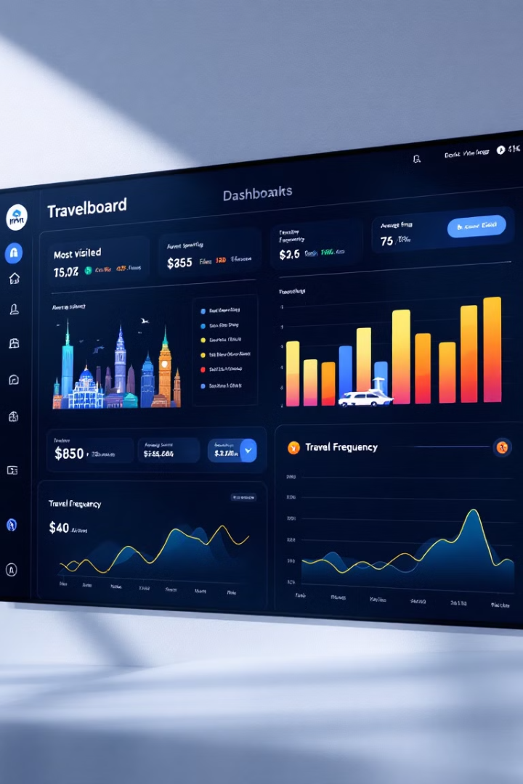
Insights and analytics: Learn from your travel patterns
Data Collection
Travel History
Expense Records
Analysis
Most Visited Destinations
Average Spending
Insights
Travel Preferences
Budgeting Patterns

Slide 12
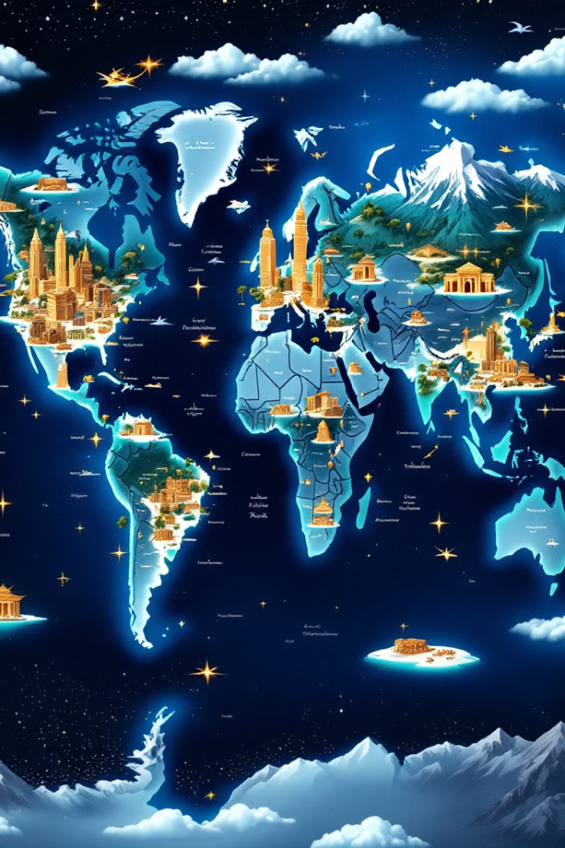
Discover New Adventures
1
Explore Local Gems
2
Activity Suggestions
Uncover hidden treasures and off-the-beaten-path destinations recommended by locals.
Get personalized recommendations for activities based on your interests and travel style.
3
Cultural Insights
Learn about local customs, traditions, and etiquette to enhance your travel experience.

Slide 13
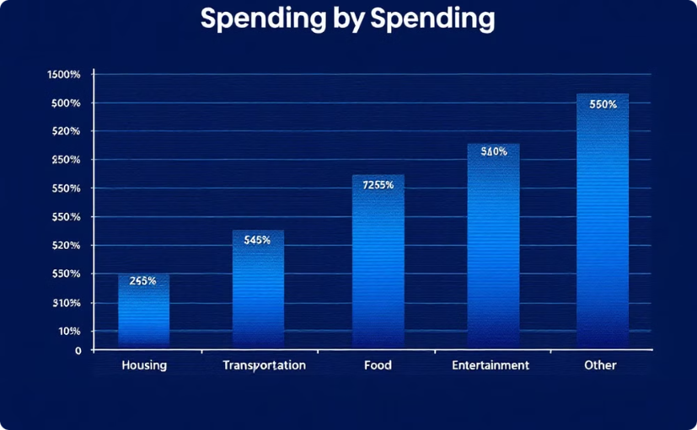
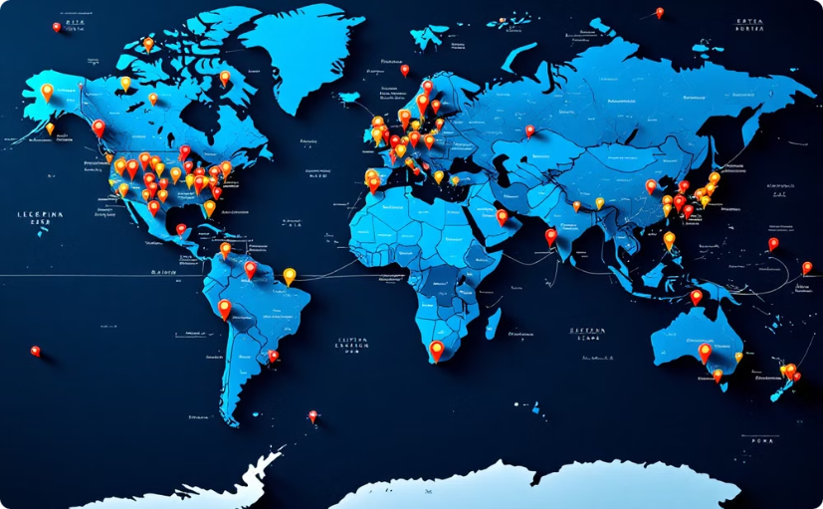
Analytics and reporting for your travels
Spending Analysis
Travel History
Gain insights into your travel expenses, identifying areas for potential savings and optimizing your budget for future trips.
Track your travel history, visualizing your destinations and providing a record of your adventures.

Slide 14
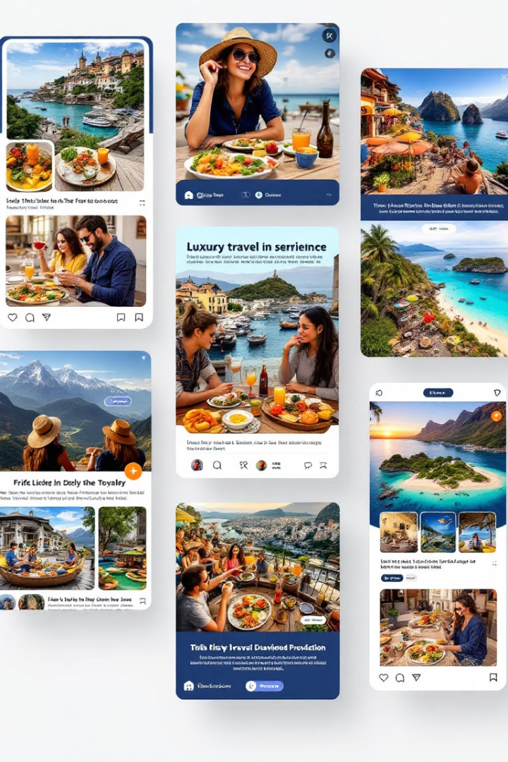



Crowdsourcing experiences: Tapping into shared knowledge
Global Perspectives
Explore a wide range of travel experiences, from hidden gems to popular attractions, based on real-life stories and reviews.
Shared Wisdom
Learn from the experiences of other travelers, get tips, avoid common pitfalls, and discover hidden gems.
Community Engagement
Connect with fellow travelers, share your own experiences, and build a community of explorers.

Slide 15
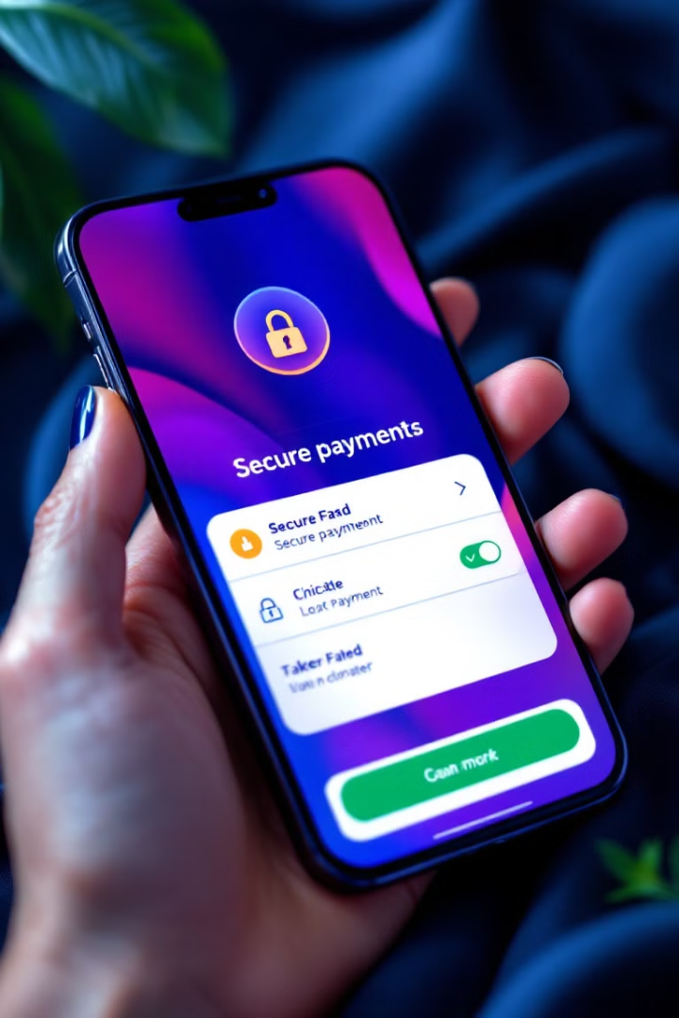
Secure your documents and payments
1
Secure Storage
2
Encrypted Payments
Store all your travel documents, including passports, visas, and tickets, securely within the app.
Use secure payment gateways to make bookings and transactions, ensuring your financial information is protected.
3
Offline Access
Access your travel documents and information offline, ensuring you're prepared even if you lose internet connectivity.

Slide 16


Shared memories: Building a community of explorers
Shared Moments
Community Connection
Capture and share your travel memories, create photo albums, and connect with fellow travelers who have similar interests.
Connect with other travelers who share your passion for exploration and build lasting friendships.

Slide 17

Collaborative problem-solving: Overcoming travel challenges
Problem
Solution
Lost luggage
Connect with local experts for advice and assistance.
Unexpected delays
Collaborate with other travelers to find alternative routes or solutions.
Language barrier
Utilize translation tools, connect with local language speakers, or ask for assistance from fellow travelers.

Slide 18
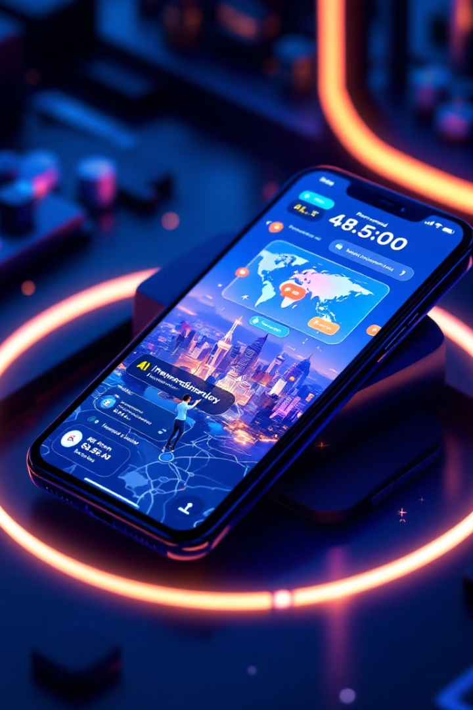



The future of travel planning: Where we're headed next
AI-powered recommendations
Personalized suggestions for destinations, hotels, and activities tailored to your preferences.
Global Connectivity
Seamless access to information, booking, and travel services worldwide.
Augmented reality experiences
Immersive travel experiences that enhance your exploration of destinations.

Slide 19
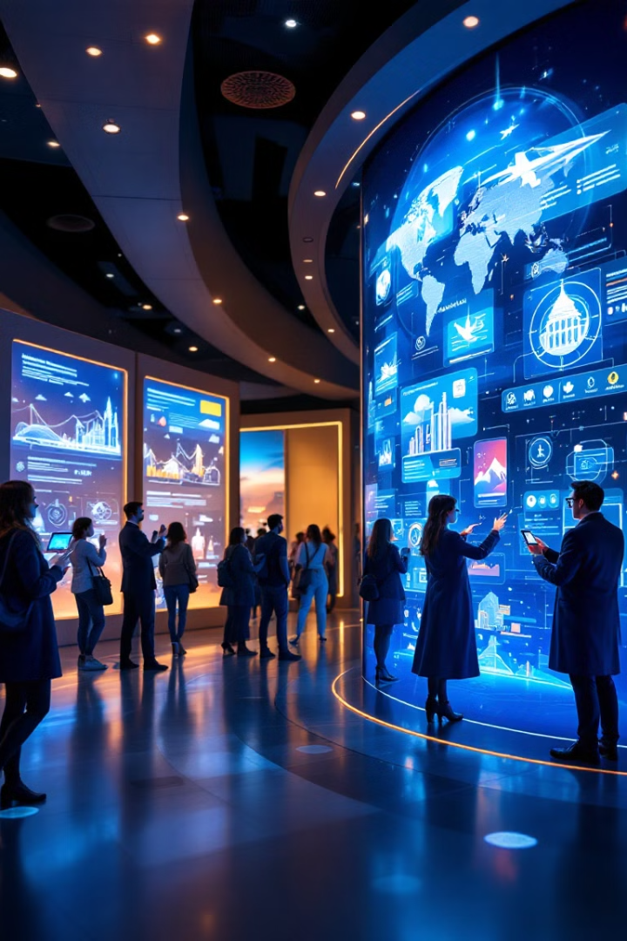
The future of travel: Embracing the power of people
Travel is constantly evolving, and the future will be powered by people. This app will continue to connect travelers, offer personalized experiences, and empower everyone to explore the world with confidence and ease.

Slide 20
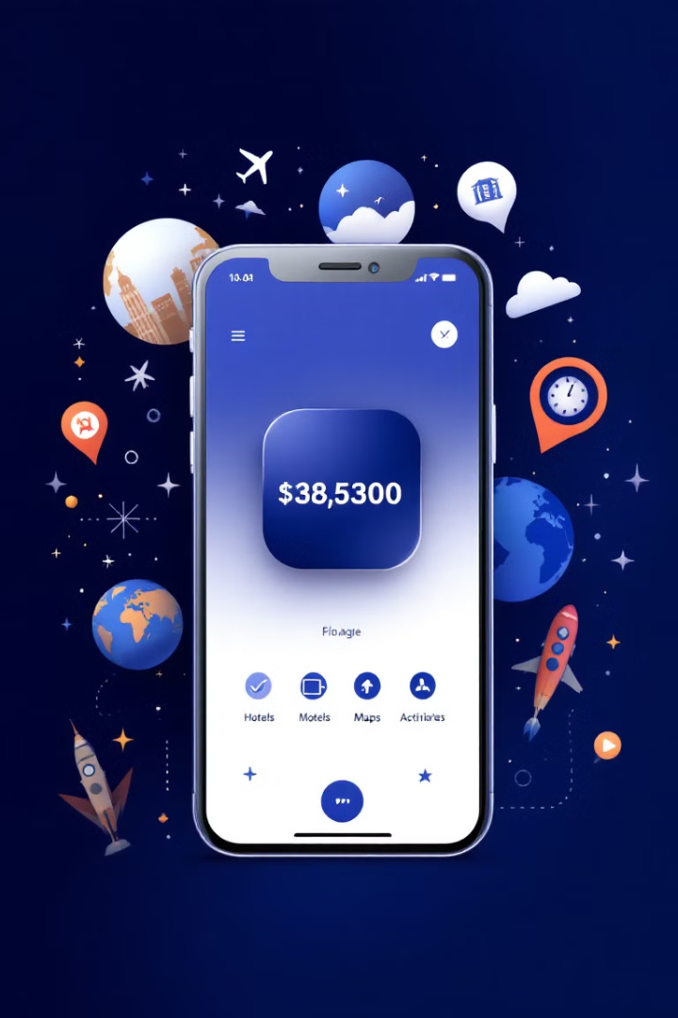
Your Essential Travel Companion
Download the app today and embark on your next adventure with confidence, ease, and excitement.

